Slide 1
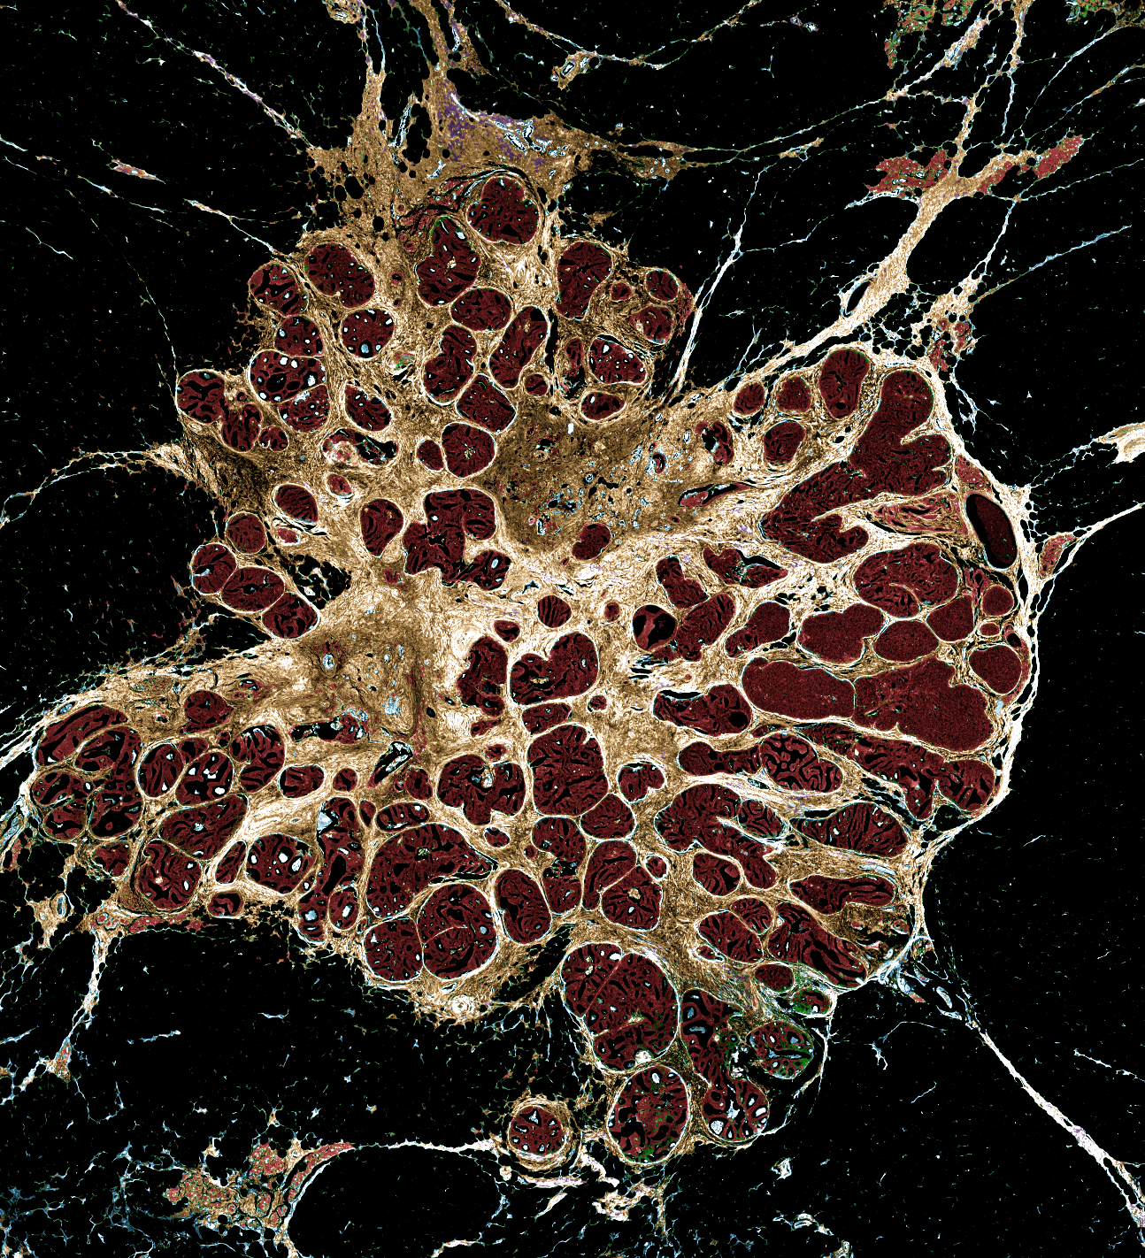
Hyperspectral Data for Tissue Segmentation: Transforming Cancer Management
Shachi Mittal
University of Illinois at Urbana-Champaign

Slide 2
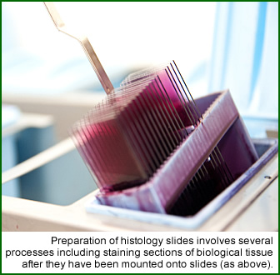
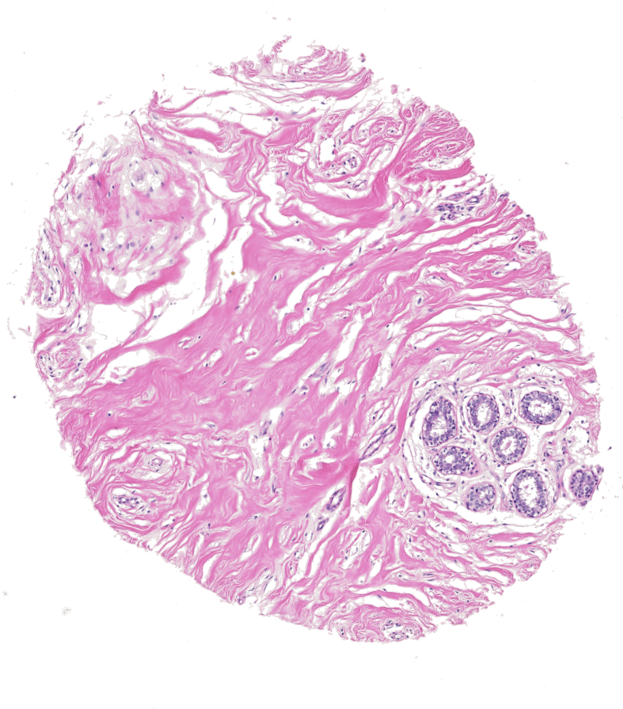

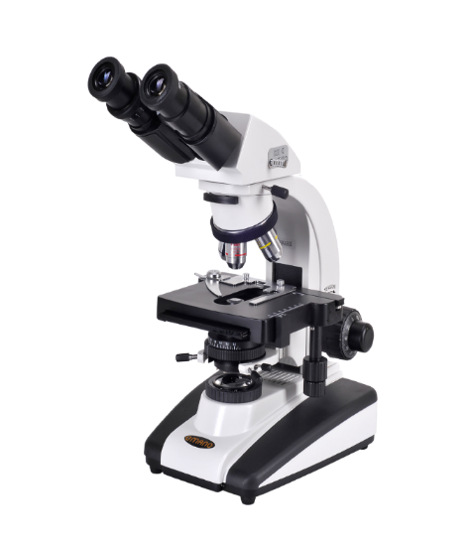
Current Workflow
Biopsy
Patient
Diagnostics
Surgery
Treatment and Planning
0.5 mm
Impact areas

Slide 3
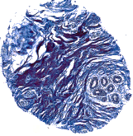
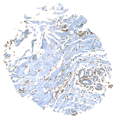
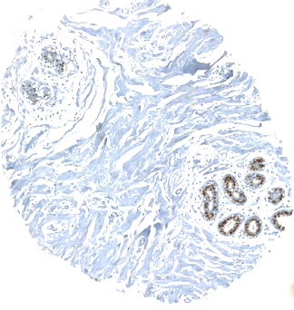

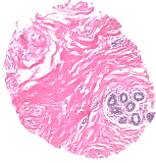
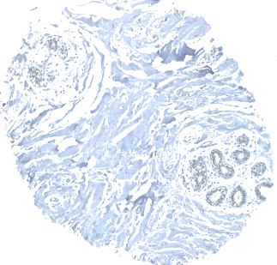
Current Challenges
Lack of standardization for biomarker assessment
Observer dependent diagnosis
Low concordance rates
Measurement error ( staining variability)
Limited field of view
Difficult to quantitate
Limited use of tissue microenvironment

Slide 4

Current Challenges
240 biopsies : Concordance rates
Benign – 87%
Invasive – 96%
DCIS – 84%
Atypical – 48%

Slide 5
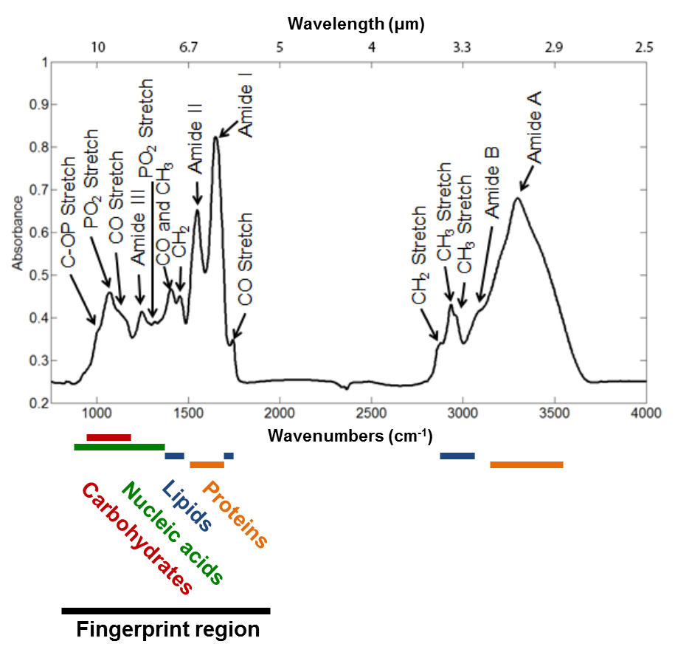

Proposed Methodology
Vibrational Spectroscopy
Chemical Imaging
Biopsies
0.6
Tissue
Infrared Light
Tissue micro-array
(TMA)
0.0
Either discrete or broadband sources
Differential absorption by cellular constituents
Typical IR spectrum of a tissue sample
Chemical image obtained by the contrast generated by a select frequency

Slide 6
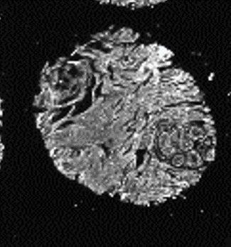
From Data to Knowledge
Selection of features
(Dimensionality Reduction)

Slide 7
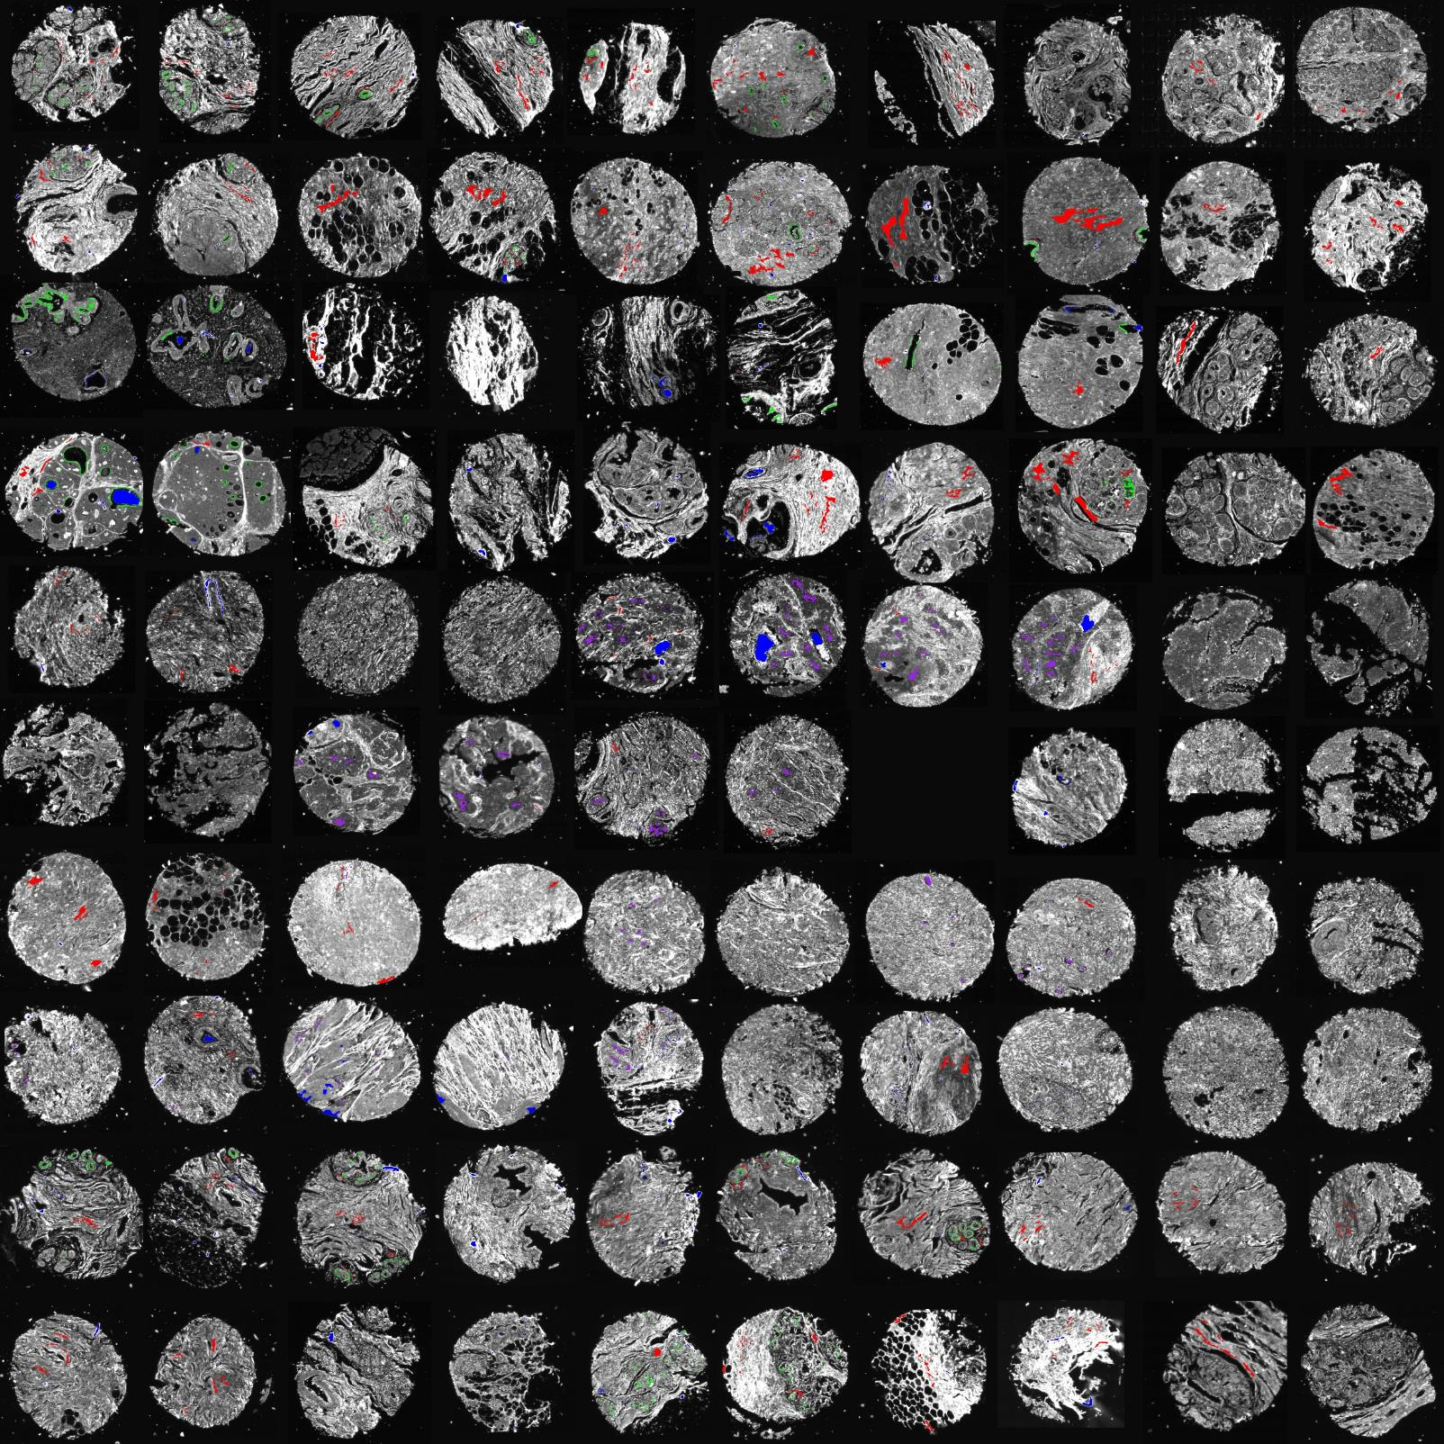
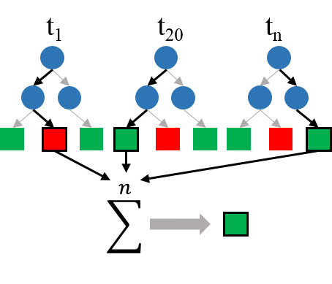
From Data to Knowledge
Selection of features
(Dimensionality Reduction)
Stroma
Noncancerous
Epithelium
Classification
Malignant
Epithelium
Others
Malignant
Epithelium
Stroma
Noncancerous
Epithelium
Others

Slide 8
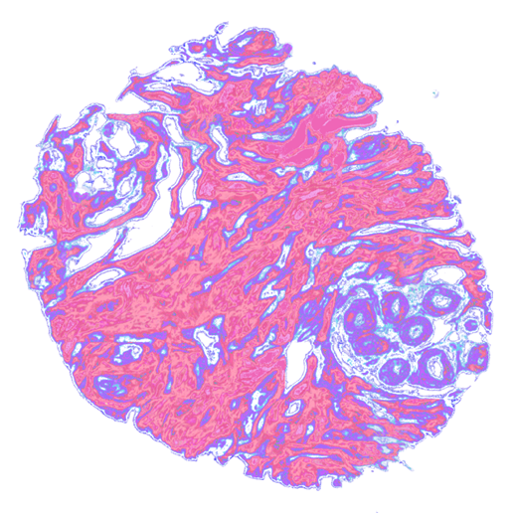
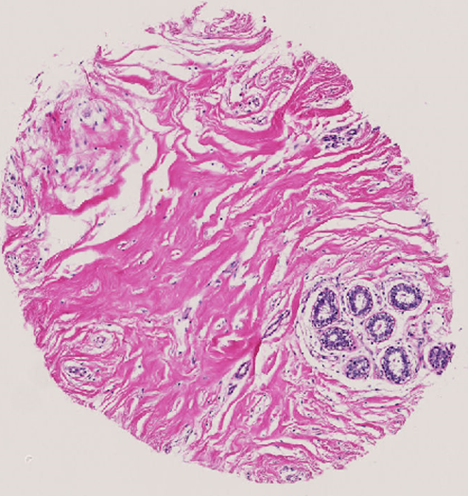
From Data to Knowledge
Stainless Staining
Digitally stained slide obtained from just the IR image
Selection of features
(Dimensionality Reduction)
Stroma
Noncancerous
Epithelium
H&E stained image
Classification
Malignant
Epithelium
Others
Malignant
Epithelium
Stroma
Noncancerous
Epithelium
Others

Slide 9
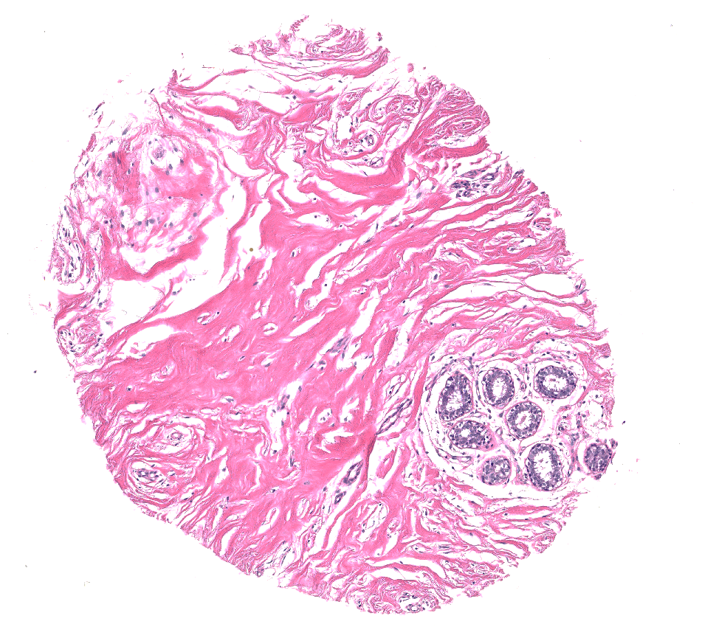
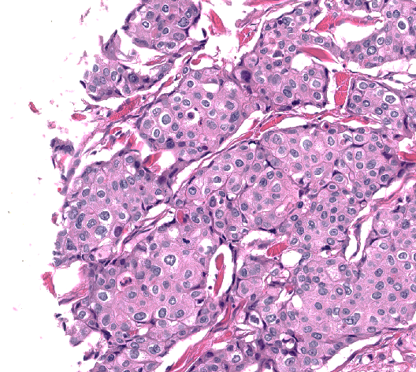
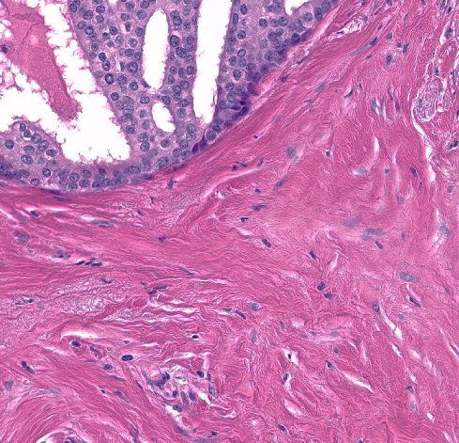
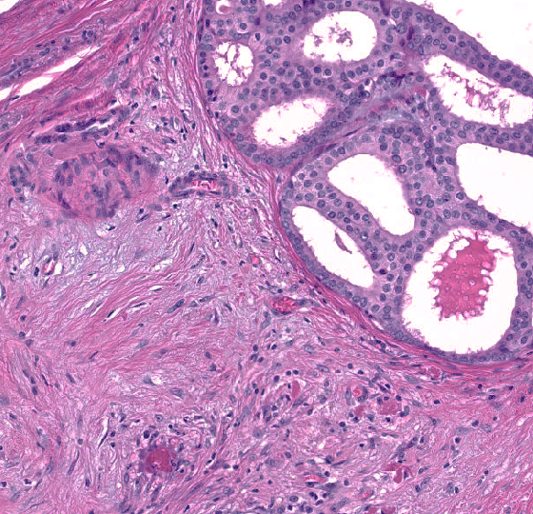
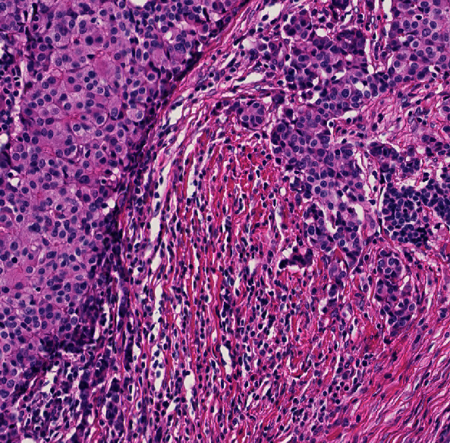
Unexplored Opportunities
Tumor Identification
Tumor Microenvironment
H&E Stained Images
Epithelial cells
Stroma
(Collagen)
Normal/Benign
Cancerous/Invasive
Normal Stroma
Desmoplasia
Desmoplasia with lymphocytes

Slide 10
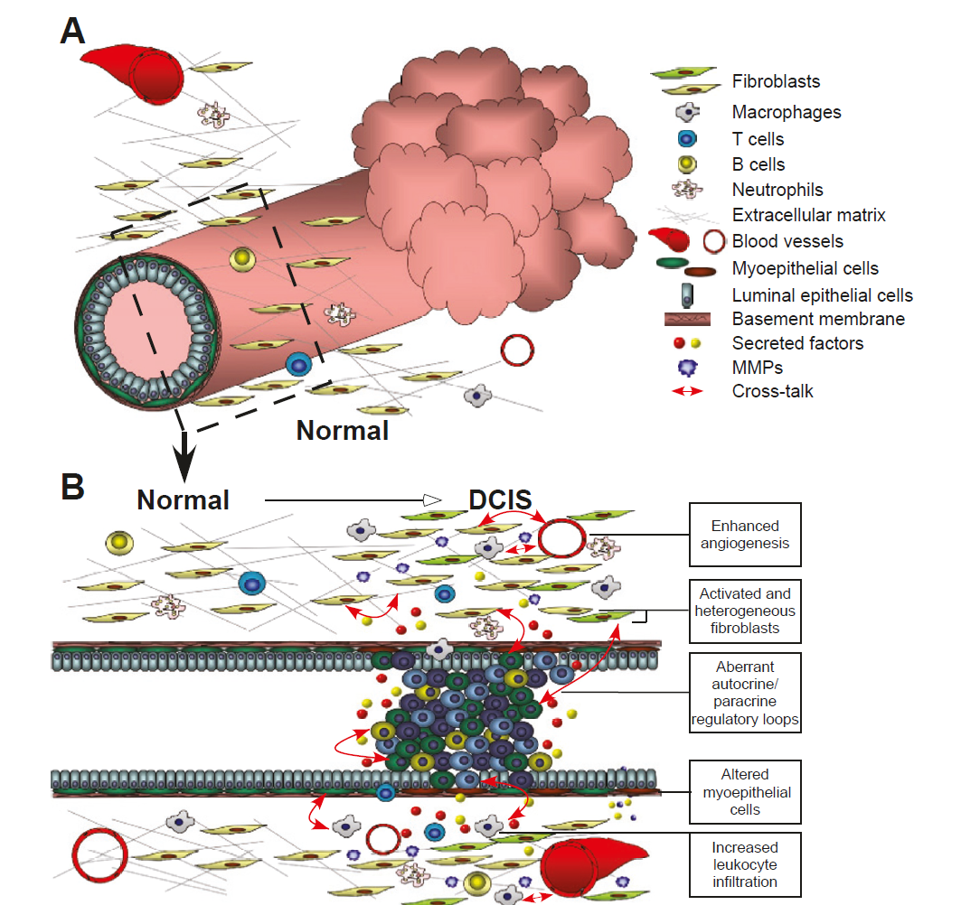
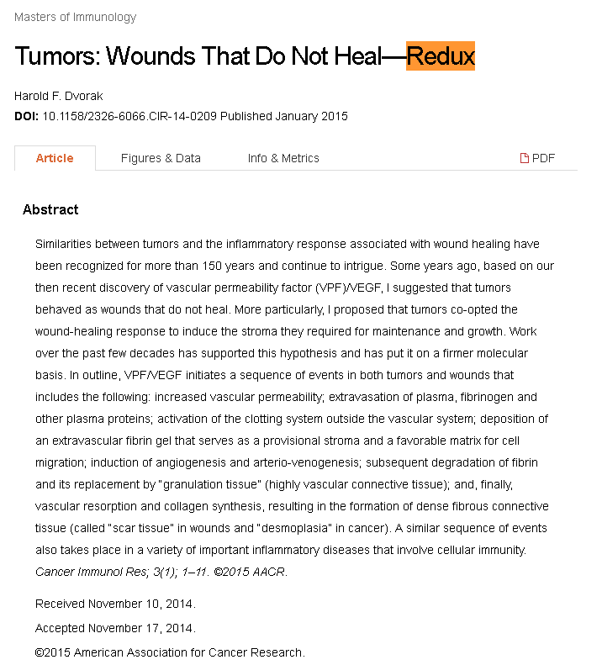
Unexplored Opportunities: Microenvironment
Breast Cancer Res. 2011; 13(6): 227.
Notes:
Similarities between tumors and the inflammatory response associated with wound healing have been recognized for more than 150 years and continue to intrigue. I proposed that tumors co-opted the wound-healing response to induce the stroma they required for maintenance and growth. Work over the past few decades has supported this hypothesis and has put it on a firmer molecular basis. In outline, VPF/VEGF initiates a sequence of events in both tumors and wounds that includes the following: increased vascular permeability; extravasation of plasma, fibrinogen and other plasma proteins; activation of the clotting system outside the vascular system; deposition of an extravascular fibrin gel that serves as a provisional stroma and a favorable matrix for cell migration; induction of angiogenesis and arterio-venogenesis; subsequent degradation of fibrin and its replacement by “granulation tissue” (highly vascular connective tissue); and, finally, vascular resorption and collagen synthesis, resulting in the formation of dense fibrous connective tissue (called “scar tissue” in wounds and “desmoplasia” in cancer).

Slide 11
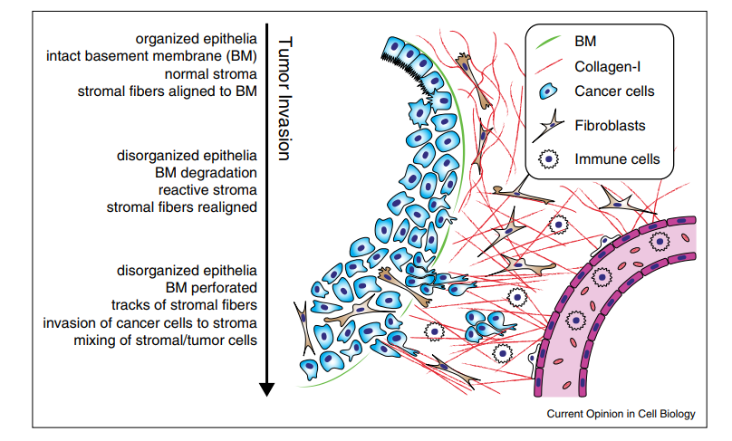
Unexplored Opportunities: Microenvironment
Curr Opin Cell Biol. 2015 Oct;36:13-22
Notes:
. In tumors of epithelial origin, or carcinomas, hypertrophic cell growth causes the epithelial layer to become many cell-layers thick. At more advanced stages, carcinoma cells often lose apical-basal polarity and apical cilia and may appear disorganized, due to reduction in cell-cell contacts and cytoskeletal reorganization (see also Figure 2a; [28]). At this ‘carcinoma in situ’ stage, the cancer cells are still encapsulated by the BM. Due to cross-talk between tumor cells and stromal cells, the stroma becomes reactive. Reactive stroma is characterized by an increased presence of immune cells and fibroblasts, which can help to deposit ECM and reorganize the stromal network (mostly made of collagen-I). Stromal network fibers are initially loosely organized and appear ‘curly’ and later increase in density and stiffness. At late stages, collagen bundles form ‘tracks’ perpendicular to the BM. In invasive tumors, cancer cells perforate the BM or migrate through regions of dysfunctional BM deposition, allowing the tumor cells to invade the stroma and migrate toward the blood stream (reviewed in [2]). Stromal cells can also enter the tumor, leading to a mixing of cell types and further disorganization of the tissue.

Slide 12
Unexplored Opportunities
Intraductal Proliferations and early Detection
Normal Cells
Dysplasia/Atypical Hyperplasia
Malignant/Invasive Tumor
Hyperplasia
Ductal Carcinoma in-situ (stage 0)
Basement Membrane

Slide 13
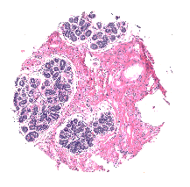
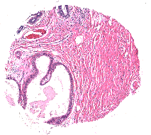
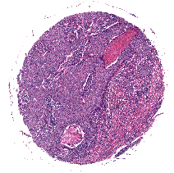
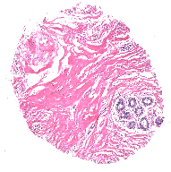
Tumor and its Microenvironment
Classified images
0.979
0.989
0.975
Hyperplasic epithelium
Dysplasic epithelium
Malignant epithelium
Stroma
0.987
Others
0.983
0.982
H&E stained images
0.972
0.972
Classified images
0.978
0.944
0.975
0.974
Normal epithelium
Malignant epithelium
Densestroma
Reactivestroma
loosestroma
Others
Mittal et al., PNAS 2018

Slide 14
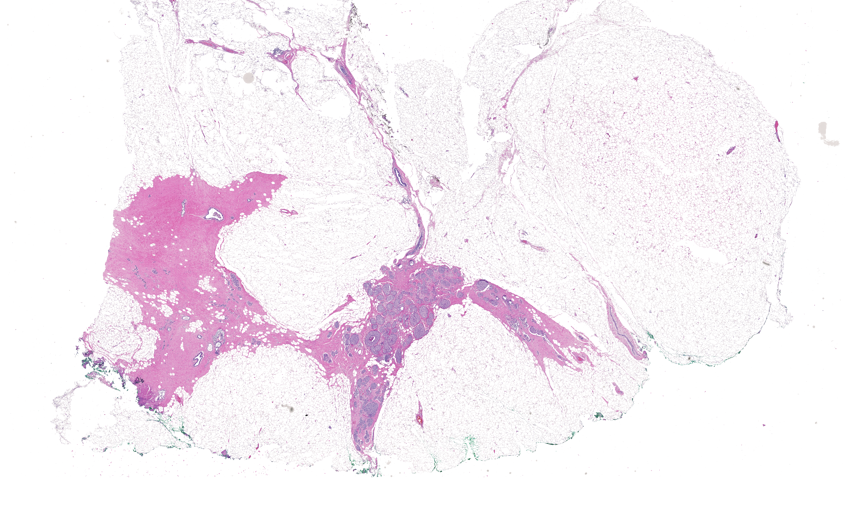
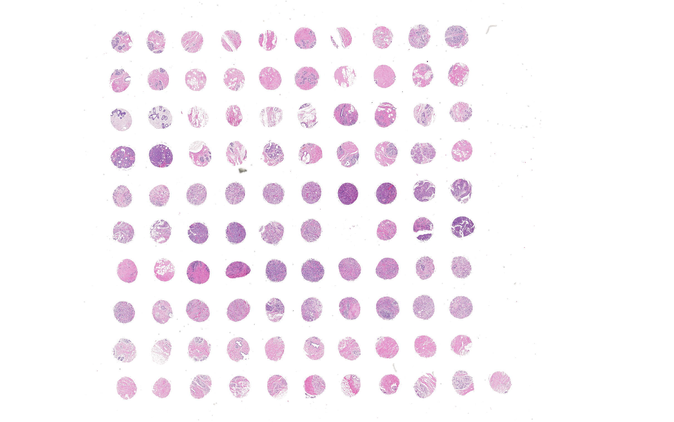
Technology to Translation
Lab Technology
Translation
Biopsies
Tissue
1 mm
1 mm
Tissue Microarray: large number of patients
Surgical Specimen: Single Patient

Slide 15
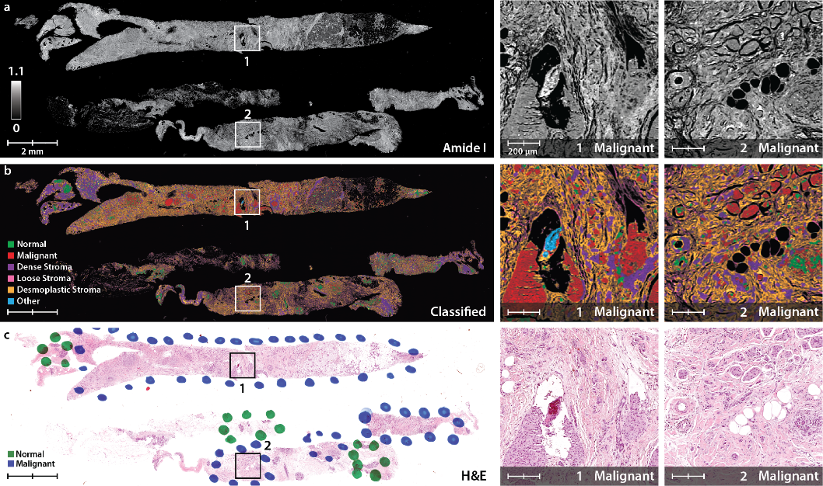
Tumor and its Microenvironment
Mittal et al., PNAS 2018

Slide 16
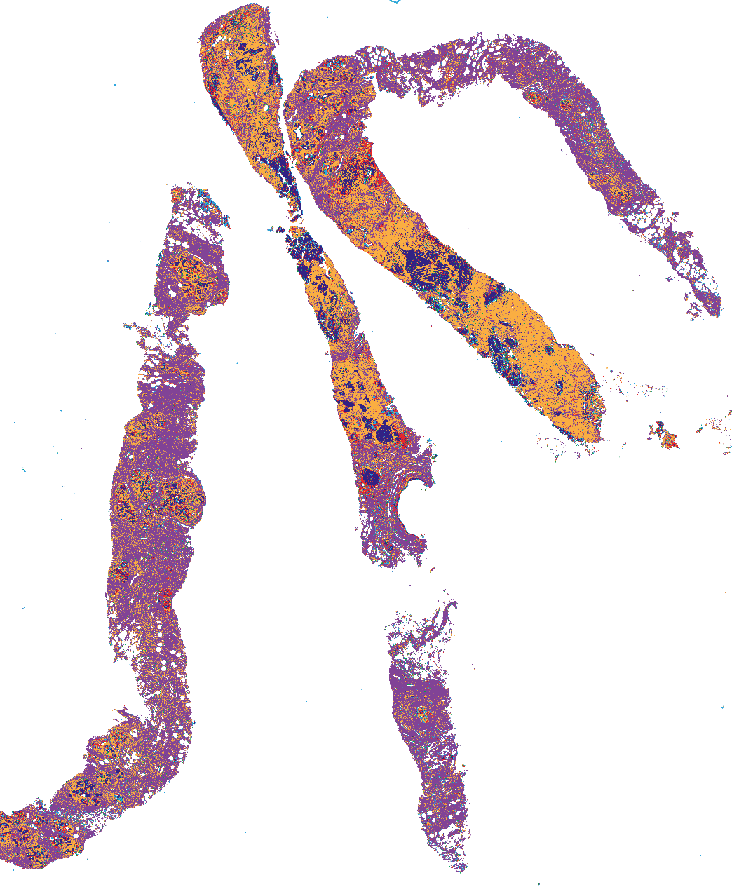
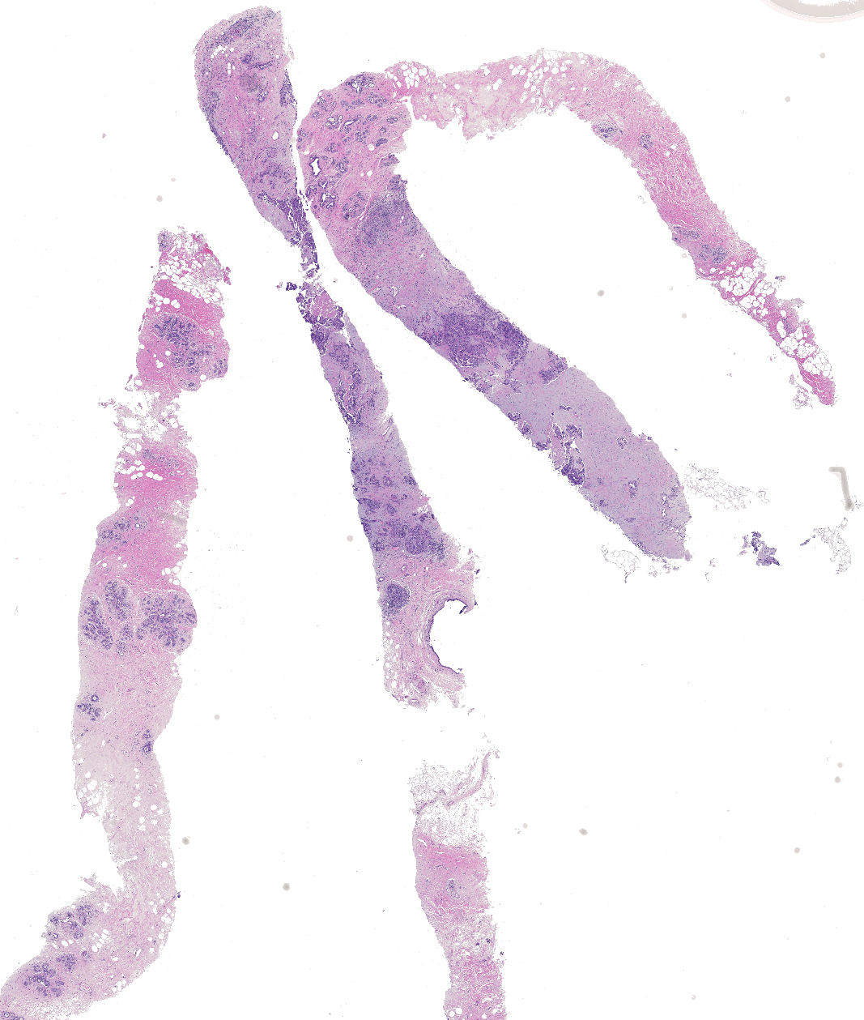
Early Detection
Classified Image
H&E stained Image
DCIS
Benign
Desmoplasia
IBC/Invasive
Densestroma
Others
1 mm

Slide 17
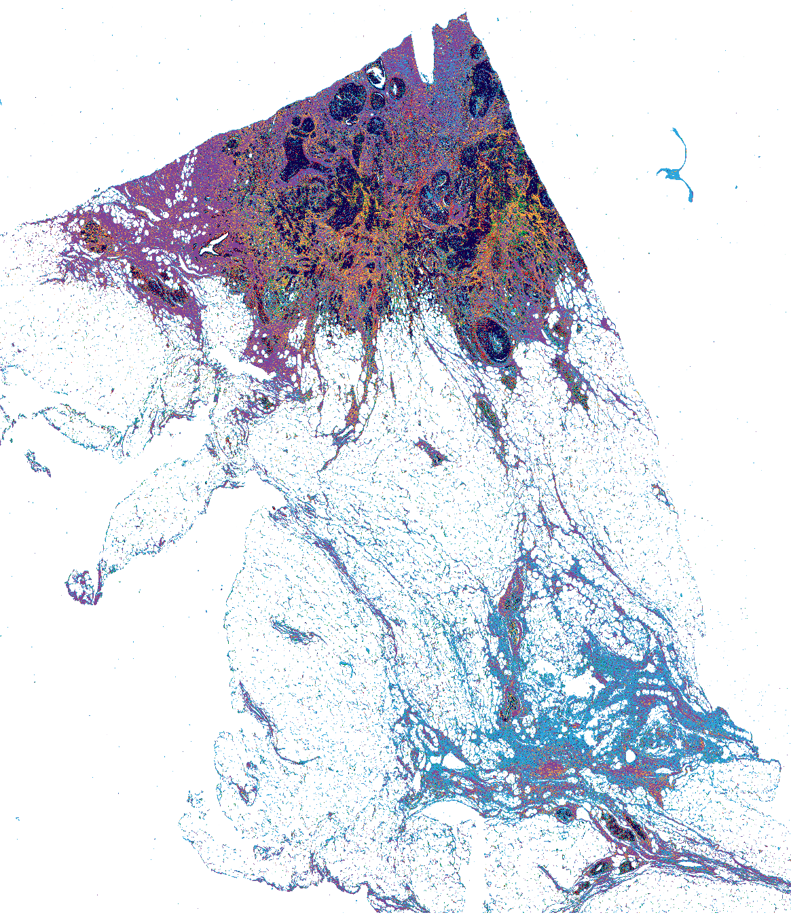
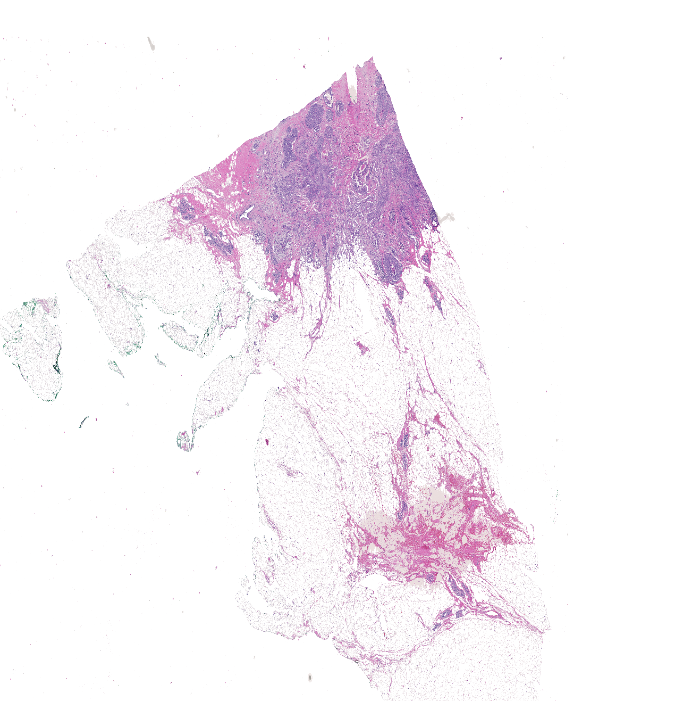
Early Detection
Classified Image
H&E stained Image
DCIS
Benign
Desmoplasia
IBC/Invasive
Densestroma
Others
1 mm

Slide 18
Tumor Grading
Indicative of how quickly a tumor is likely to grow and spread
Identified based on how abnormal the tumor cells look under a microscope
Organization close to normal cells-> well – differentiated tumors ( grow and spread slowly)
Abnormal looking cells lacking normal structures-> poorly differentiated ( grows rapidly)
Grade 1
Grade 2
Grade 3

Slide 19
Tumor Grading

Slide 20
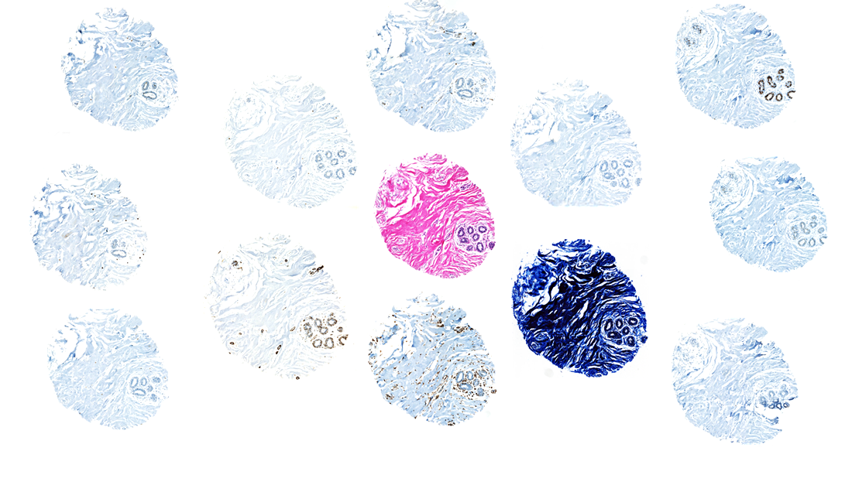
Morphology to Molecular
Ki67
H&E
PR
Cytokeratin
Calponin
P53
ER
SMA
TR1
P63
Vimentin
HER2/neu

Slide 21
Morphology to Molecular
Ki67
P63
Vimentin
PR
Cell proliferation
Nuclear stain
Prognostic factor
Interpretation
< 10% - low
10 – 20% - borderline
> 20% - high
Myoepithelial Marker
Nuclear stain
Interpretation
Rule out invasion
Mesenchymal Marker
Cytoplasmic stain
Interpretation
Significant in high grade infiltrating ductal carcinoma
Progesterone Receptor
Nuclear stain
Interpretation
Predicts response to tamoxifen or other anti-estrogen drugs
Only adds limited amount of additional predictive information as compared to ER
SMA
Smooth muscle cells, myo-fibroblasts and myoepithelial cells
Nuclear stain
Interpretation
Rule out invasion but also stains stromal cells
ER
P53
Estrogen Receptor
Nuclear stain
Interpretation
Predicts response to tamoxifen or other anti-estrogen drugs
Tumor suppressor gene => DNA repair
Nuclear stain
Interpretation
Abnormal P53 expression => Brown
> 5% nuclei
Calponin
CD31
Myoepithelial Marker
Nuclear stain
Interpretation
Rule out invasion
Endothelial cells
Membranous stain
Interpretation
Degree of Angiogenesis

Slide 22
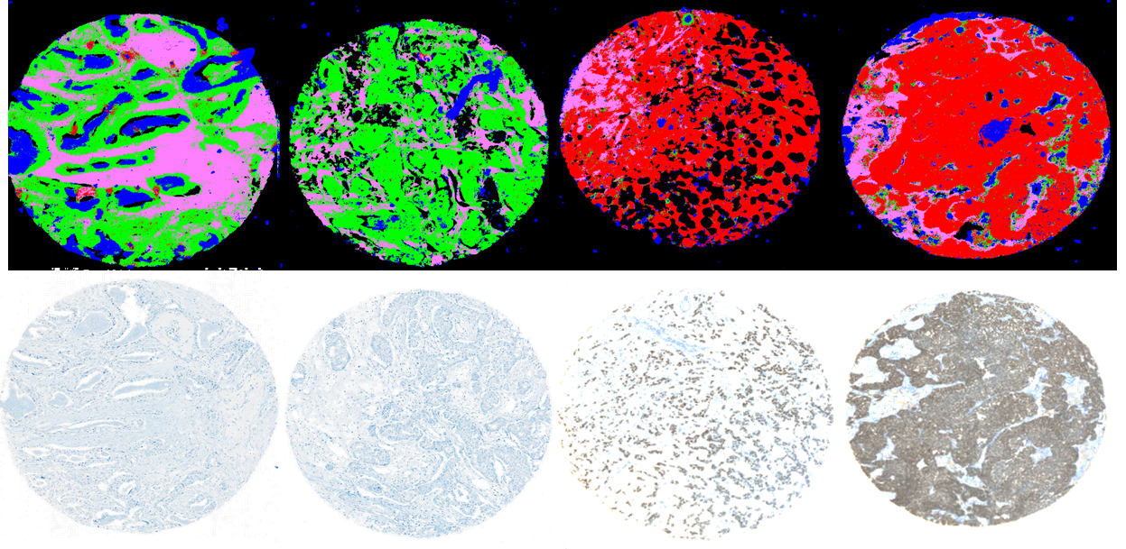
Hormone Receptor Status
ER Status
HER2 Status
Stroma
ER positive
ER negative
Others
Simultaneous assessment of diagnostic and molecular profile
Reduced cost and rapid testing

Slide 23
Clinical Impact
IR imaging captures inherent signatures of tumor development and progression
Rapid IR imaging can further be developed as a clinically relevant diagnostic tool
IR based digital molecular histopathology can both complement and extend current histopathological diagnosis

Slide 24







Thank you for listening!
Would love to take your questions!
Mentor
Research Funding
Healthcare Partners
Prof. Rohit Bhargava

